Slide 1
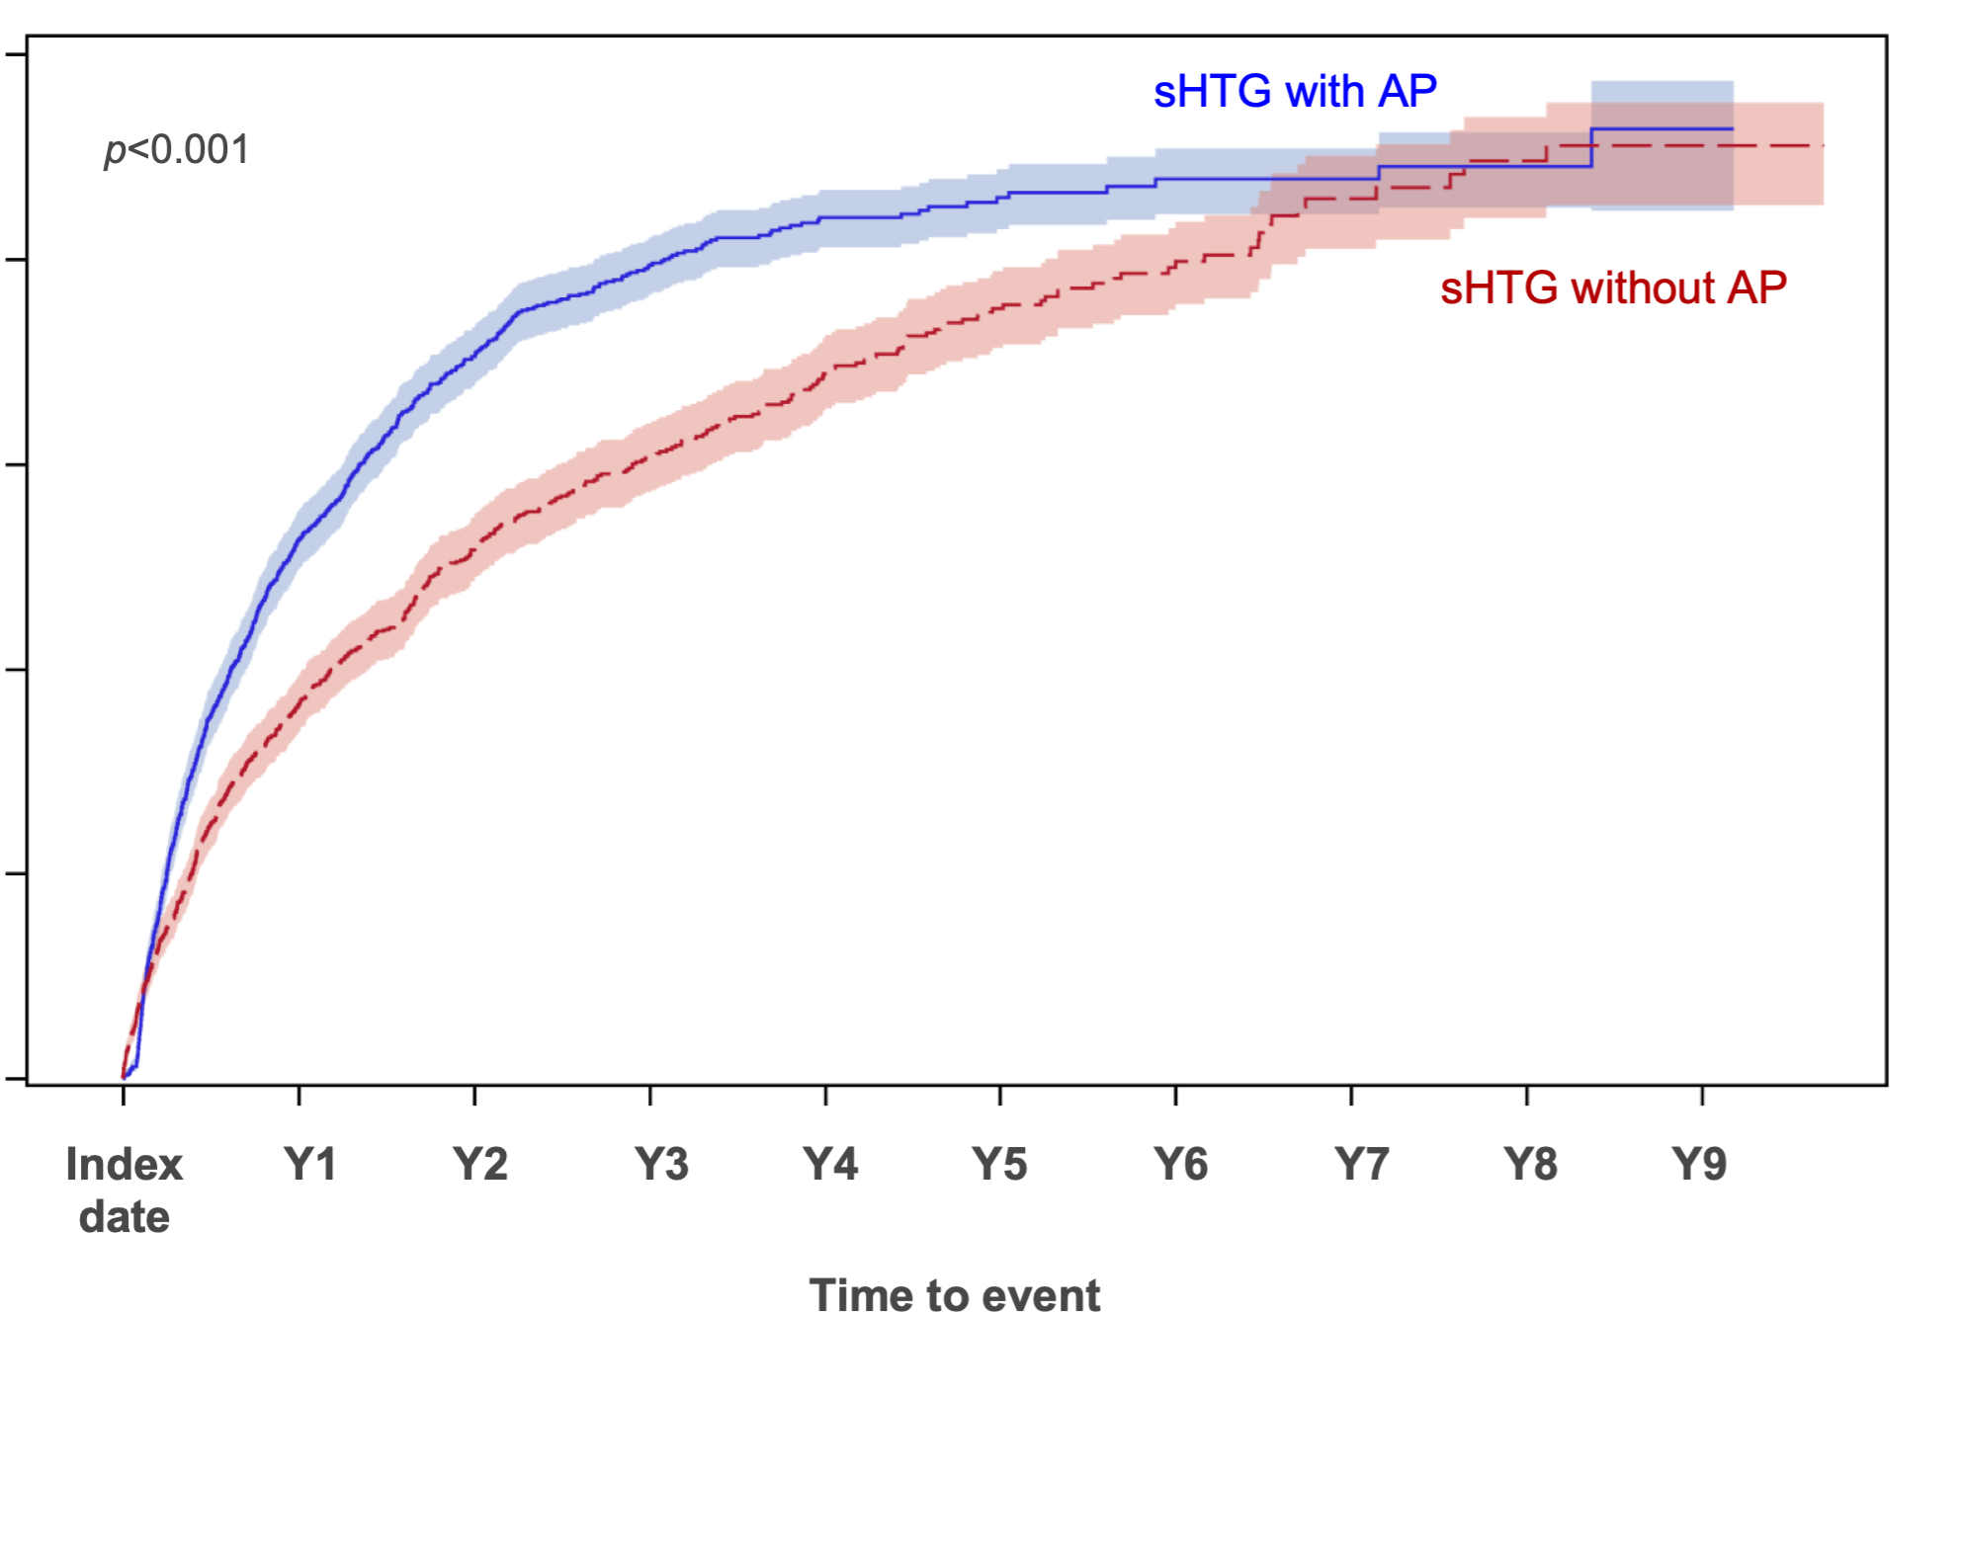
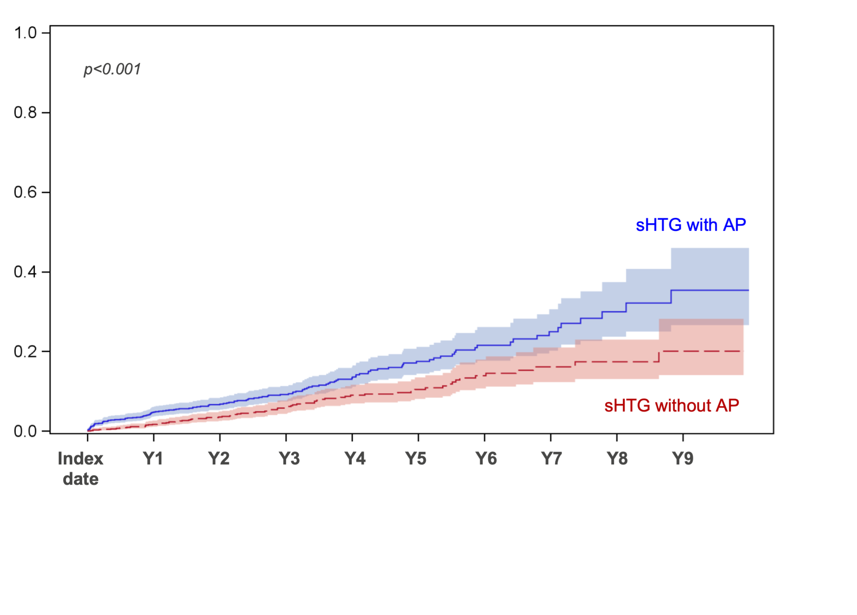

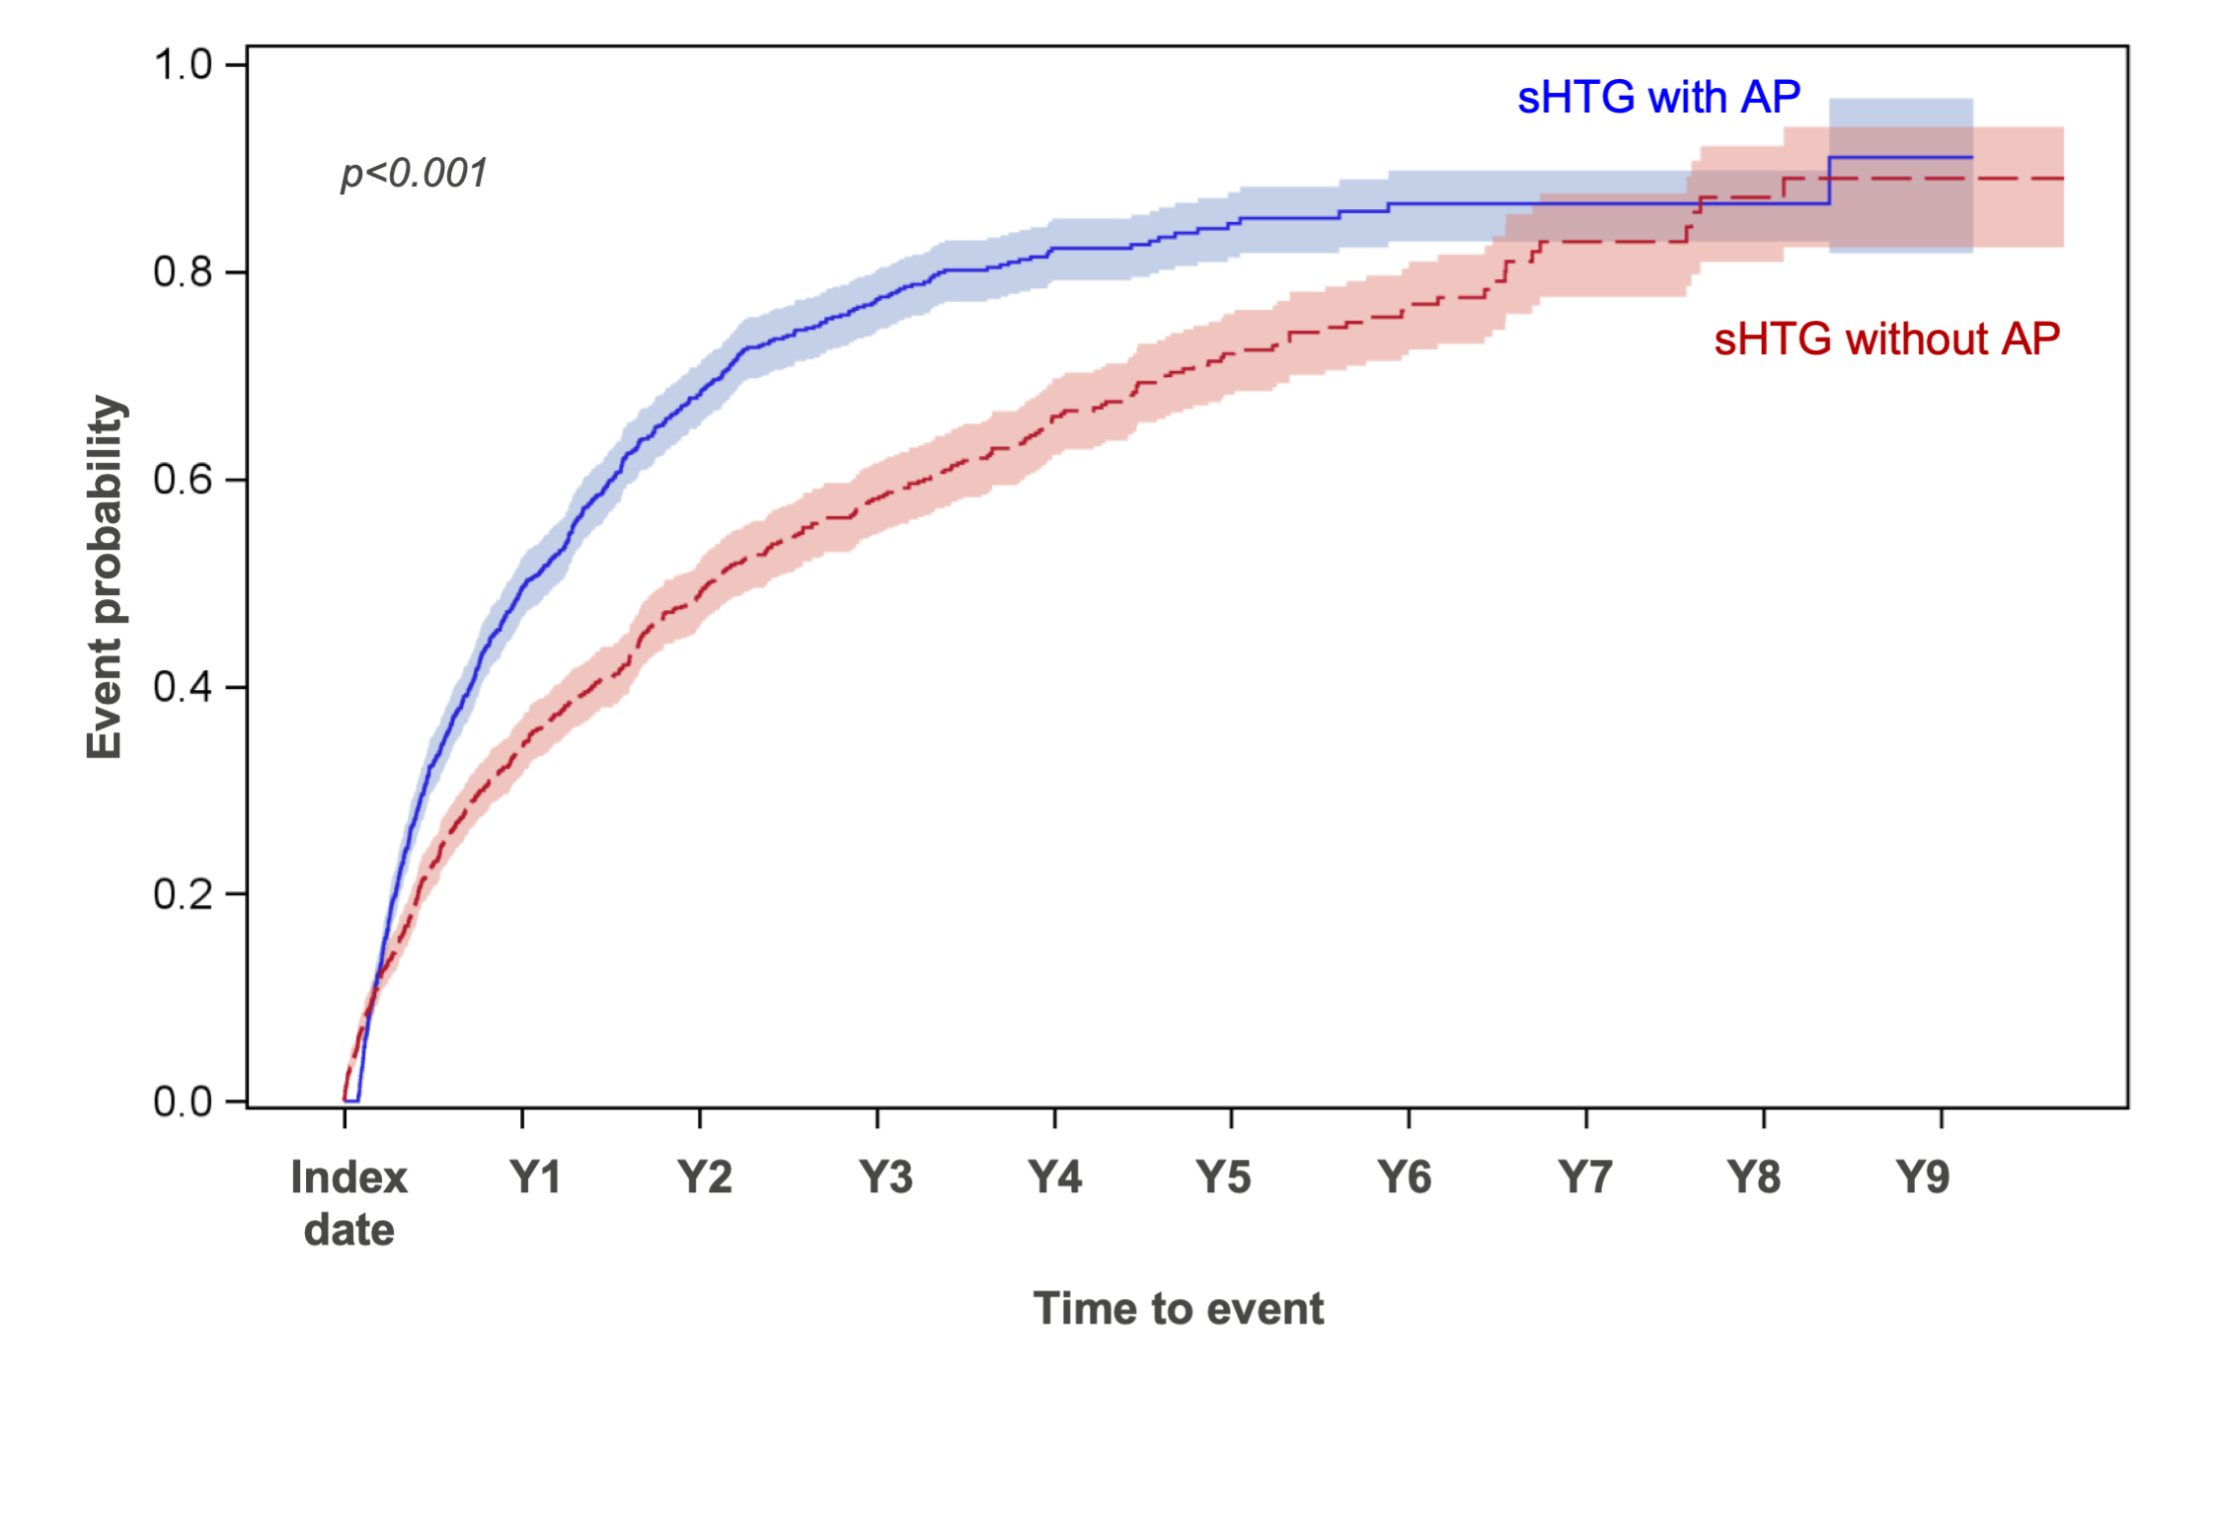
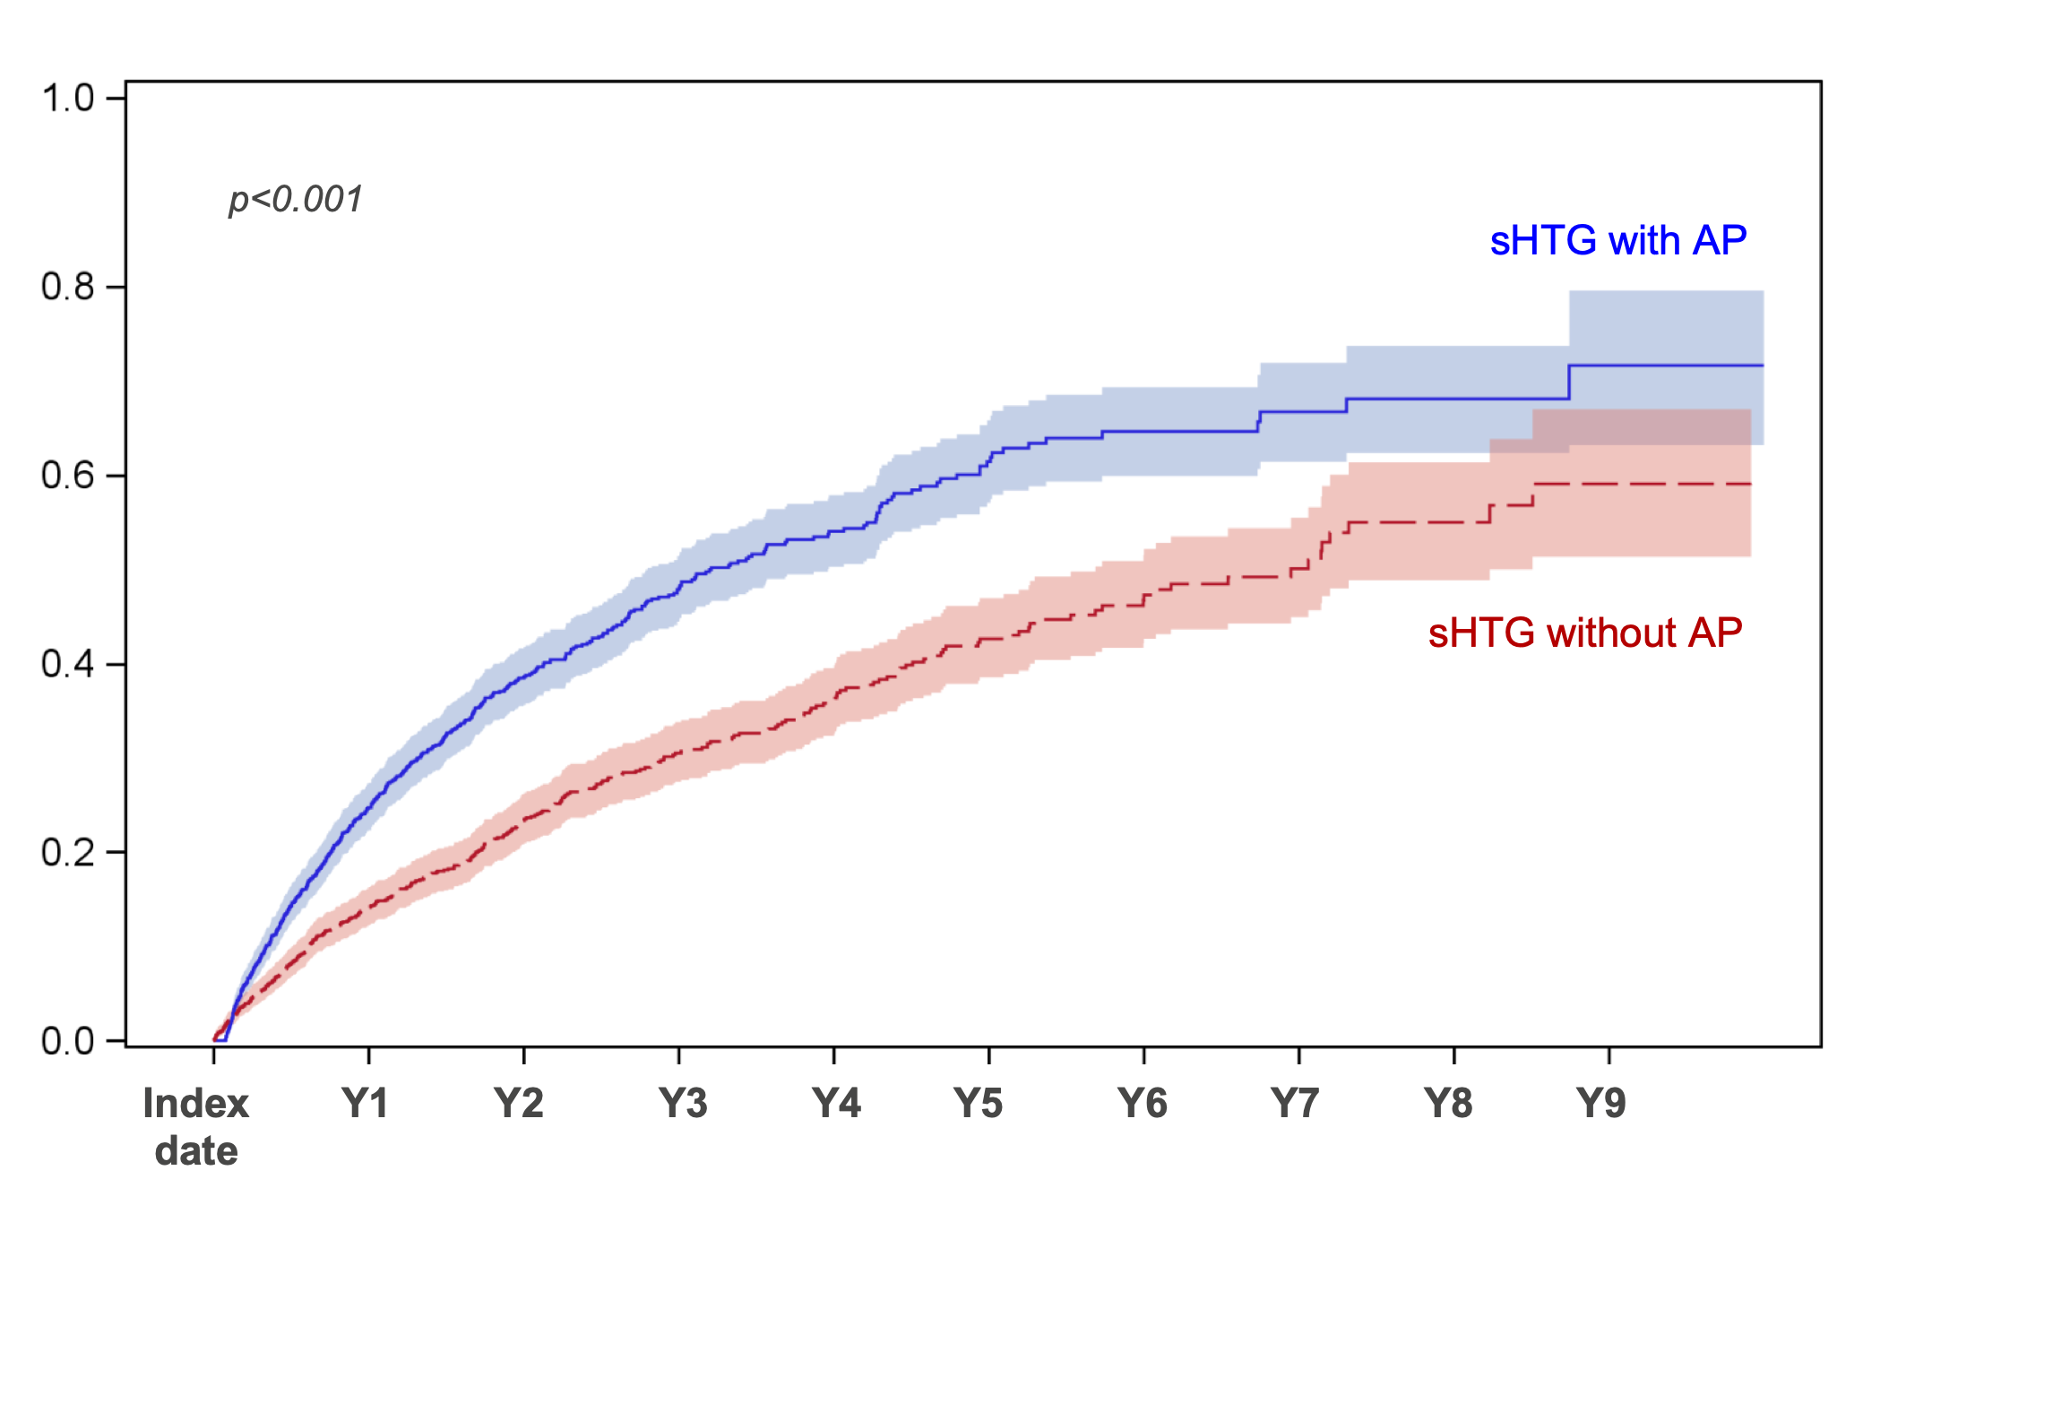
#118
Worse Health Outcomes and Survival of Patients With Severe Hypertriglyceridemia After Acute Pancreatitis
Michael S. Broder, MD, MSHS¹, Eunice Chang, PhD¹, Jonathan L. Respress, PhD, MBA², Kathleen F. Villa, MS², Nathan D. Wong, PhD, MPH, FACC, FAHA, FNLA, MASPC³
¹PHAR (Partnership for Health Analytic Research, LLC), Beverly Hills, CA, USA, ²Ionis Pharmaceuticals, Carlsbad, CA, USA, ³University of California, Irvine, School of Medicine, Irvine, CA, USA
Background/Synopsis
1 in 4 US adults, including nearly 1 in 3 on statin therapy, have hypertriglyceridemia (HTG).¹ A 2011 study estimated the prevalence of severe HTG (sHTG) (defined as triglyceride [TG] level 500-20,000 mg/dL) to be roughly 3.4 million adults in the US.² Patients with sHTG are at risk for acute pancreatitis (AP), with risk increasing with rising TG levels.³⁻⁵ sHTG-induced AP (sHTG-AP) is associated with significant morbidity, mortality, and healthcare utilization and costs.^{6–9} The literature lacks recent, real-world data on health outcomes associated with sHTG-AP and its relationship to patient mortality is not well established.^{3,7,9} This study aimed to broadly estimate the extent to which patients with sHTG-AP subsequently have differing health outcomes compared to patients with sHTG without AP.
Methods (cont.)
Statistical analysis Propensity score matching was conducted to identify matched patients with sHTG without AP to patients with sHTG-AP in a 1:1 ratio. The score was estimated using a logistic regression model which included: sociodemographics, insurance, comorbidities, statin and non-statin lipid-lowering medication use, GLP-1 use, index TG value, and total cholesterol. Patients were matched on index TG value categories (500-879, 880-999, 1000-1999, 2000-15000 mg/dL), baseline diabetes, and index year. The greedy nearest neighbor method with caliper width of 0.2 of the standard deviation of the logit of the propensity score was used for propensity score matching. Standardized differences were used to check balance diagnostics, and all had effect sizes ≤0.2. Descriptive statistics were used to examine patient characteristics and healthcare utilization. Outcomes were compared between sHTG-AP and sHTG without AP using Chi-square test, t-test, and log rank test for categorical, continuous, and survival variables, respectively.
Table 2. TG tests during follow-up*
 | Matched
 | sHTG-AP | sHTG without AP
Had a post TG test during follow up period, n | 956 | 951
TG value (mg/dL) over follow-up, mean (SD) | 544.9 (524.7) | 383.3 (354.6)
Last TG value (mg/dL), mean (SD) | 499.7 (613.4) | 363.4 (398.6)
*Mean (SD) follow-up for all patients 3.0 (2.2) years.
Figure 1. ED visits, hospitalizations, and deaths during follow-up
A. First ED visit, inpatient hospitalization, or death
B. Death
Methods
Conducted a retrospective cohort study using data from a large, integrated US-based administrative health database (January 1, 2012 - December 31, 2022). Adult patients (≥18 years) with sHTG (500-15,000 mg/dL) between January 1, 2013 and December 31, 2021 (identification period, ID). From this identified group, 2 cohorts were created: patients with sHTG with AP and patients with sHTG without AP. All patients were followed for ≥6 months after the index date (or died within 6 months). sHTG-AP patients Diagnosis of AP (ICD-9-CM: 577.0; ICD-10-CM: K85.xx, except for K85.2 and K85.3) during ID period. First AP diagnosis date was used as the index date and the baseline sHTG value (within 12 months prior to the index date) closest in time to the index date used as the index test. sHTG without AP patients Patients with a sHTG value during ID period who were not included in sHTG-AP cohort. If patients had multiple qualifying sHTG values, one was randomly selected as the index test. To qualify, there had to have been no evidence of AP during 12 months before or after the test. Index date randomly assigned after the index TG test date. Exclusion criteria Noncontinuous health plan enrollment during baseline period (12 months prior to the index date). Evidence of the following during baseline period: alcohol-induced diagnoses (e.g., alcohol-induced chronic pancreatitis), drug induced AP, other chronic pancreatitis, biliary obstruction, gallstones, hypercalcemia, and acute coronary syndrome, stroke, or transient ischemic attack within 3 months prior to the index date. Measures Baseline: demographics, comorbidities, physician characteristics, laboratory results, and treatment use. Follow-up period: comorbidities (e.g., Charlson comorbidity index [CCI]), healthcare utilization, emergency department (ED) visits, hospitalizations, overall survival, and laboratory results (e.g., TG levels).
1.0
p<0.001*
sHTG with AP
1.0
p<0.001*
Results
Matching resulted in 1,197 in each group. Patients were well matched on all matching characteristics and baseline measures (absolute values of all standardized mean differences were ≤0.2). Patient characteristics are shown in Table 1. Mortality during follow-up was 11.4% for sHTG-AP vs. 6.5% for sHTG without AP (p<0.001). Patients with sHTG-AP were more likely to have an ED visit during the follow-up period vs. patients with sHTG without AP (90.6% vs. 54.5%, p<0.001) or to be hospitalized (72.0% vs. 29.2%, p<0.001). The risk of death, ED visit, and hospitalization were each statistically significantly higher in patients with sHTG-AP compared to sHTG without AP, over the follow-up period (Figure 1).
Event probability
sHTG without AP
sHTG with AP
0.0
0.0
Index date
sHTG without AP
Index date
Y1
Y2
Y3
Y4
Y5
Y6
Y7
Y8
Y9
Y1
Y2
Y3
Y4
Y5
Y6
Y7
Y8
Y9
Time to event
Time to event
C. First ED visit
D. First inpatient hospitalization
1.0
p<0.001*
sHTG with AP
1.0
p<0.001*
sHTG with AP
Table 1. Patient characteristics at baseline after matching
Event probability
sHTG without AP
 | Matched
 | sHTG-AP | sHTG without AP
N | 1,197 | 1,197
Age, mean (SD) years | 54.5 (13.4) | 54.5 (13.3)
Female, n (%) | 409 (34.2) | 409 (34.2)
Race, n (%)
Asian | 46 (3.8) | 34 (2.8)
Black | 121 (10.1) | 131 (10.9)
Hispanic | 263 (22.0) | 267 (22.3)
White | 711 (59.4) | 701 (58.6)
Unknown | 56 (4.7) | 64 (5.3)
Insurance type, n (%)
Commercial | 710 (59.3) | 710 (59.3)
Medicare | 487 (40.7) | 487 (40.7)
Years of follow-up, mean (SD) | 2.9 (2.1) | 3.0 (2.2)
CCI, mean (SD) | 2.7 (2.8) | 2.7 (2.7)
Comorbidities, n (%)
Chronic liver disease | 194 (16.2) | 199 (16.6)
Chronic kidney disease | 239 (20.0) | 240 (20.1)
Type 2 diabetes | 772 (64.5) | 771 (64.4)
Disorders of lipoprotein metabolism and other lipidemias* | 1,069 (89.3) | 1,070 (89.4)
Index TG value (mg/dL), n (SD) | 1,143 (1,074.7) | 1,115 (1,117.6)
Total cholesterol value (mg/dL), mean (SD) | 268.6 (433.3) | 269.7 (545.4)
Lipid-lowering treatment, n (%) | 935 (78.1) | 945 (78.9)
sHTG without AP
0.0
Index date
Y1
Y2
Y3
Y4
Y5
Y6
Y7
Y8
Y9
0.0
Index date
Y1
Y2
Y3
Y4
Y5
Y6
Y7
Y8
Y9
Time to event
Time to event
* by log-rank test
sHTG= severe hypertriglyceridemia; AP=acute pancreatitis; ED=emergency department; Y=year
Conclusion
Beginning from an initial episode of AP, patients with sHTG in this large national sample had significantly worse health outcomes than sHTG patients who had not had AP. Preventing initial episodes of AP in patients with sHTG may have important health benefits. Establishing a causal link between AP and the outcomes measured will require additional research. Research is also needed in patients with sHTG without AP compared to the general population as mortality, ED visits, and hospitalizations are still high.
References
[1] Fan et al. J Clin Lipidol. 2019;13(1):100-108.
[2] Christian et al. Am J Cardiol. 2011;107(6):891-897.
[3] Garg et al. BioMed Res Int. 2018;2018:1-12.
[4] Ata et al. Yemen J Med. 2022;1(1):2-5.
[5] Ewald et al. Curr Opin Lipidol. 2009;20(6):497-504.
[6] Zafrir et al. Pancreas. 2019;48(2):182-186.
[7] Toth et al. Atherosclerosis. 2014;237(2):790-797.
[8] Kichloo et al. Gastroenterol Res. 2022;15(1):19-25.
[9] Rashid et al. Pancreas. 2017;46(1):57-63.
Disclosures
All authors declare the following: support for the present presentation (e.g., funding, provision of study materials, medical writing, etc.): Ionis Pharmaceuticals. MSB and EC are employees of PHAR, which was paid by Ionis Pharmaceuticals to conduct the research described in the presentation. PHAR also discloses financial relationships with the following entities outside of the submitted work: AbbVie, Akcea, Amgen, AstraZeneca, BioMarin Pharmaceuticals, Bristol-Myers Squibb, Boston Scientific Corporation, Eisai, Ethicon, Genentech, Gilead, Novartis, Otsuka, Pfizer, Recordati, Regeneron, Sanofi US Services, Sunovion, Takeda Pharmaceuticals USA. JLR and KFV report the following: support for the present presentation: Ionis Pharmaceuticals; JLR and KFV are employees and shareholders of Ionis Pharmaceuticals. NDW reports the following: support for the present presentation: Ionis Pharmaceuticals; consulting fees: Ionis Pharmaceuticals.
sHTG=severe hypertriglyceridemia; AP=acute pancreatitis; CCI=Charlson comorbidity index; SD=standard deviation; TG=triglycerides
*Does not include hypertriglyceridemia
Poster presented at NLA Scientific Sessions, Las Vegas, NV, May 30 - June 2, 2024
This study was funded by Ionis Pharmaceuticals.

